Slide 1



SAP Process Integration
(SAP PI)
Day 4
16th – 20th
March, 2020
Trainer: Gopal
Kirti

Slide 2


Contents
1
Monitoring in SAP PI
Alert Mechanism
Types of Mapping in SAP PI
Node functions in SAP PI
2
3
4
5
User-defined functions
Copyright © Capgemini 2016 All Rights Reserved
2

Slide 3
Runtime workbench in SAP PI
Central PI Monitoring offers the following options:
Format of PI Message
Message Monitor
Communication Channel Monitor
Performance Monitor
Java Proxy Runtime Monitor
Cache Monitor
Engine Status
IDOC Monitor
CPA Cache History
Channel Independent logs
Component Based Alert
Copyright © Capgemini 2016. All Rights Reserved
3

Slide 4
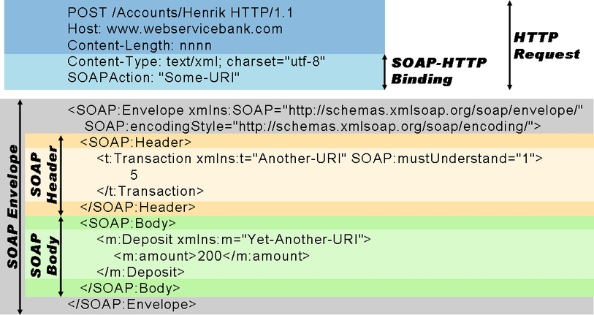
Format of PI Message
In SAP PI, Runtime Workbench(RWB) can be accessed using the below URL:
http://host:port/rwb
Example of basic SOAP document over HTTP
Copyright © Capgemini 2016. All Rights Reserved
3

Slide 5
Format of PI Message
Example of basic SOAP document over HTTP
Copyright © Capgemini 2016. All Rights Reserved
3

Slide 6
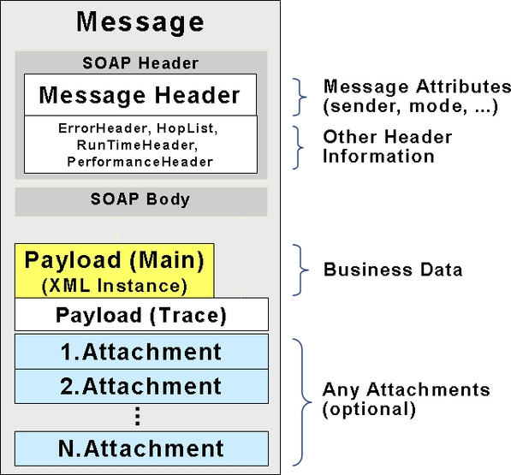
PI Message format: SOAP with attachments
Copyright © Capgemini 2016. All Rights Reserved

Slide 7
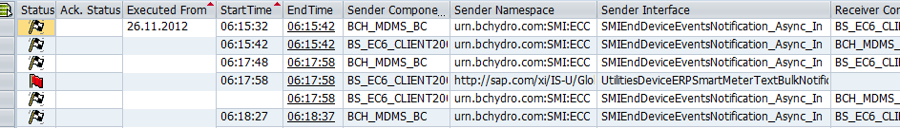
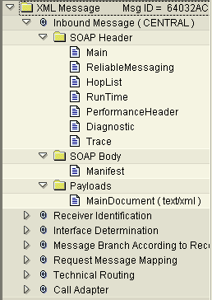
Viewing SOAP message parts within PI
The transaction for monitoring messages in ABAP system is SXMB_MONI (Monitor for processed XML messages).
Each node represents a pipeline step
The contents of the node corresponds to the state of the message after the pipeline step.
Each message part can be viewed individually
Copyright © Capgemini 2016. All Rights Reserved
6

Slide 8
Message Monitor
Display message processing including aggregated and detailed information about status of messages, identify errors in message processing and perform problem isolation. Manage individual messages by, for example, resending individual message versions.
Open a browser and go to http://<host>:<port>/pimon to access the Process Integration tools.
Then choose Monitoring >> Adapter Engine >> Message Monitor for Adapter engine Monitoring
Choose Monitoring >> Integration Engine >> Message Monitor for Integration engine Monitoring
Click on the Message Monitor
In the message monitor, you can access the message overview or search for persisted or archived messages as described below.
Copyright © Capgemini 2016. All Rights Reserved

Slide 9
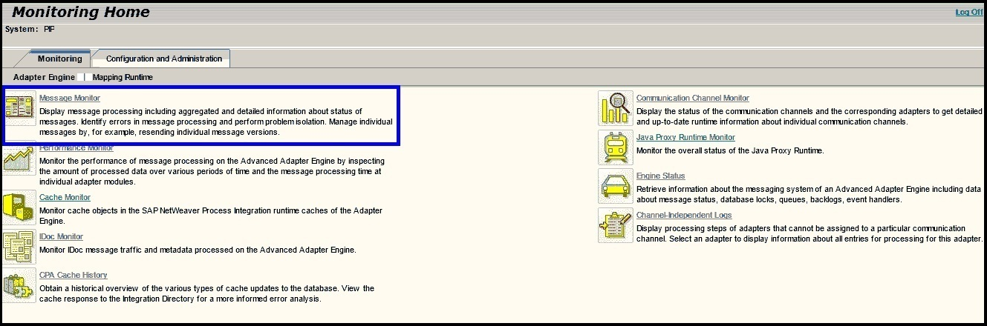
Message Monitor
Copyright © Capgemini 2016. All Rights Reserved

Slide 10
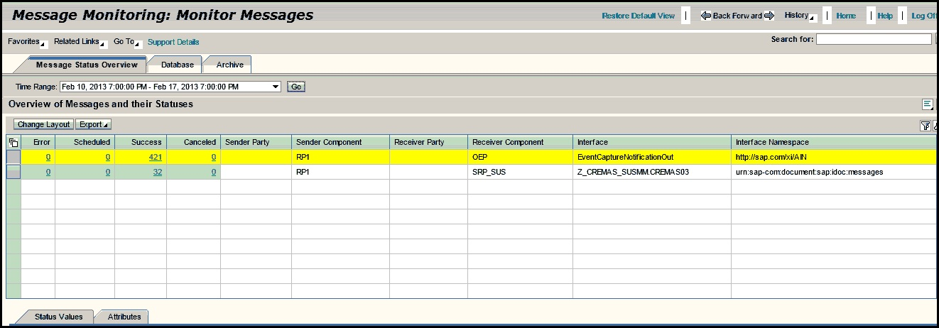
Message Monitor
Copyright © Capgemini 2016. All Rights Reserved

Slide 11
Message Status Overview Message Status Overview will allow you to get a quick overview of the entire message flows sorted by interfaces and status. Overview of Messages and their Statuses shows: 1. Error 2. Scheduled 3. Success 4. Cancelled Run the transaction for each component is the PI system every hour in the production system. The transaction should be run once a day in the development and testing systems. (It vary depends upon the project requirements)
Copyright © Capgemini 2016. All Rights Reserved

Slide 12
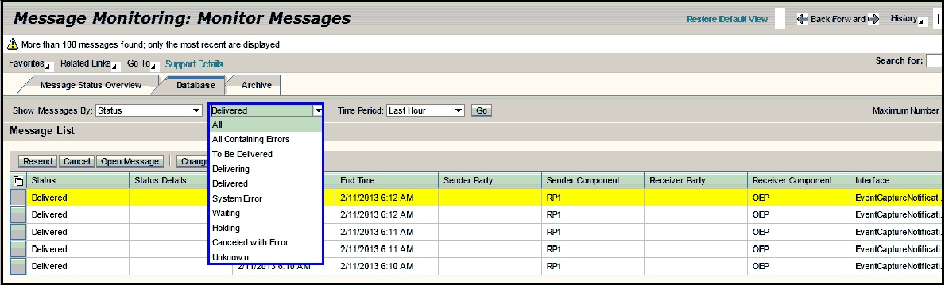
Database
Set the time option to cover the last hour for the production system and last day for other systems and access the information by pressing display.
Analyze any errors or cancelled with errors and attempt to fix any problems.
Run the monitor regularly in the production system. The transaction should be run once a day in the development and testing systems (It vary according to project requirements).
Copyright © Capgemini 2016. All Rights Reserved

Slide 13
Database
The Adapter Engine’s Messaging System (MS) receives the message, processes it and forwards it to the receiver. While the MS processes the message, it passes several statuses:
● TO_BE_DELIVERED: The state of message when it is initially handed over to the Messaging System.
● DELIVERING: The state of message when it has popped out of the MS queuing system and is in the process of being transmitted across the wire or delivered to an application.
● DELIVERED: The state of message when it has successfully reached its intended recipient.
● SYSTEM ERROR: The state of issues with the messages that are flowing through the PI side that can be stuck for several reasons.
● HOLDING: The state of an EOIO message that cannot be delivered until its predecessors have been delivered.
● WAITING: The state of a message that has been attempted to be sent at least once, failed, and is currently waiting for another attempt.
Copyright © Capgemini 2016. All Rights Reserved

Slide 14
Communication Channel Monitor
Display the status of the communication channels and the corresponding adapters to get detailed and up-to-date runtime information about individual communication channels. Communication Channel Monitor could be accessed in one of the following ways
Open a browser and go http://<host>:<port>/pimon to access the Process Integration tools. Then choose Monitoring >> Adapter Engine >> Communication Channel Monitor.
Click on the Communication Channel Monitor.
The components of the PI system should be analyzed regular basis in the production system. The transaction should be run once a day in the development and testing systems.
Contd.
Copyright © Capgemini 2016. All Rights Reserved
13

Slide 15
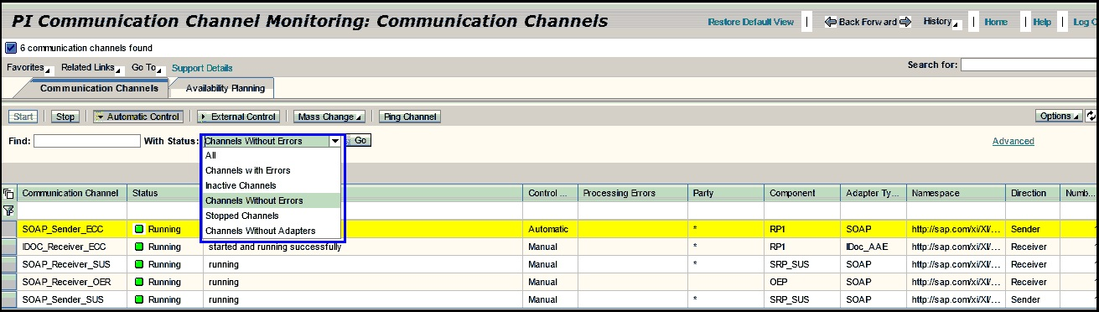
Communication Channel Monitor
Copyright © Capgemini 2016. All Rights Reserved
14

Slide 16
Performance Monitor
Monitor the performance of message processing on the Advanced Adapter Engine by inspecting the amount of processed data over various periods of time and the message processing time at individual adapter modules.
Performance Monitor could be accessed in one of the following ways:
Open a browser and go to http://<host>:<port>/pimon to access the Process Integration tools. Then choose Monitoring >> Adapter Engine >> Performance Monitor.
Click on the Performance Monitor
Contd.
Copyright © Capgemini 2016. All Rights Reserved
15

Slide 17
Java Proxy Run Time Monitor
Monitor the overall status of the Java Proxy Run time.
Java Proxy Run Time Monitor could be accessed in one of the following ways:
Open a browser and go to http://<host>:<port>/pimon to access the Process Integration tools. Then choose Monitoring >> Adapter Engine >> Java Proxy Run time Monitor.
Click on the Java Proxy Run time Monitor
Copyright © Capgemini 2016. All Rights Reserved
15

Slide 18
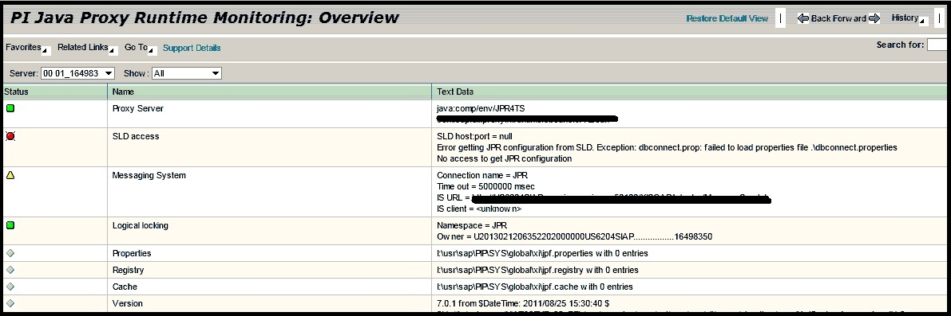
Java Proxy Run Time Monitor
Copyright © Capgemini 2016. All Rights Reserved
15

Slide 19
Cache Monitor
Monitor cache objects in the SAP Net Weaver Process Integration run time caches of the Adapter Engine.
Cache Monitor could be accessed in one of the following ways:
Open a browser and go to http://<host>:<port>/pimon to access the Process Integration tools. Then choose Monitoring >> Adapter Engine >> Cache Monitor.
Click on the Cache Monitor
Copyright © Capgemini 2016. All Rights Reserved
15

Slide 20
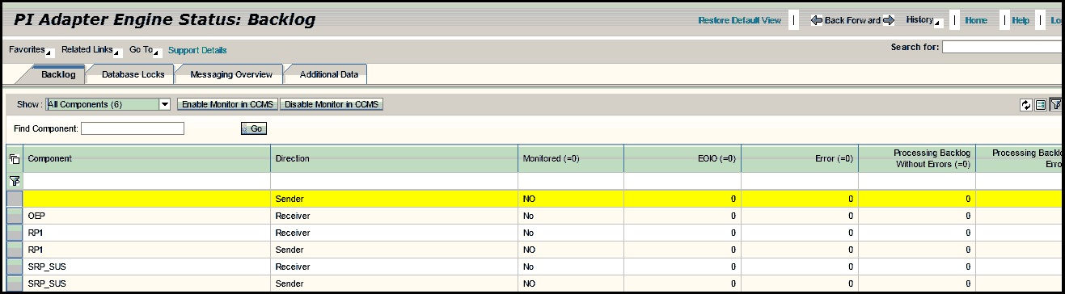
Engine Status
Retrieve information about the messaging system of an Advanced Adapter Engine including data about message status, database locks, queues, backlogs, event handlers.
Engine Status could be accessed in one of the following ways:
Open a browser and go to http://<host>:<port>/pimon to access the Process Integration tools. Then choose Monitoring >> Adapter Engine >> Engine Status.
Click on the Engine Status
Copyright © Capgemini 2016. All Rights Reserved
15

Slide 21
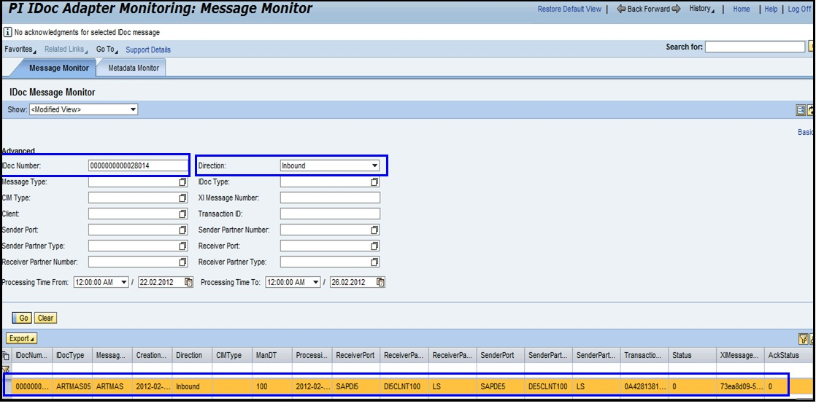
IDOC Monitor
Monitor IDoc message traffic and meta data processed on the Advanced Adapter Engine.
IDOC Monitor could be accessed in one of the following ways:
Open a browser and go to http://<host>:<port>/pimon to access the Process Integration tools. Then choose Monitoring >> Adapter Engine >> IDOC Monitor
Click on the IDOC Monitor
Copyright © Capgemini 2016. All Rights Reserved
15

Slide 22
Procedure
Choose the Message Monitor tab.
Choose one of the following search modes:
>> To perform a quick search, simply select one of the options in the Show drop-down menu.
>> In basic search mode, you can enter the number of the IDoc message in the Find field, and specify the message direction and the time period.
>> In advanced search mode, you can enter parameters of the IDoc or XI message as well as the start and end of the search period.
Copyright © Capgemini 2016. All Rights Reserved
15

Slide 23
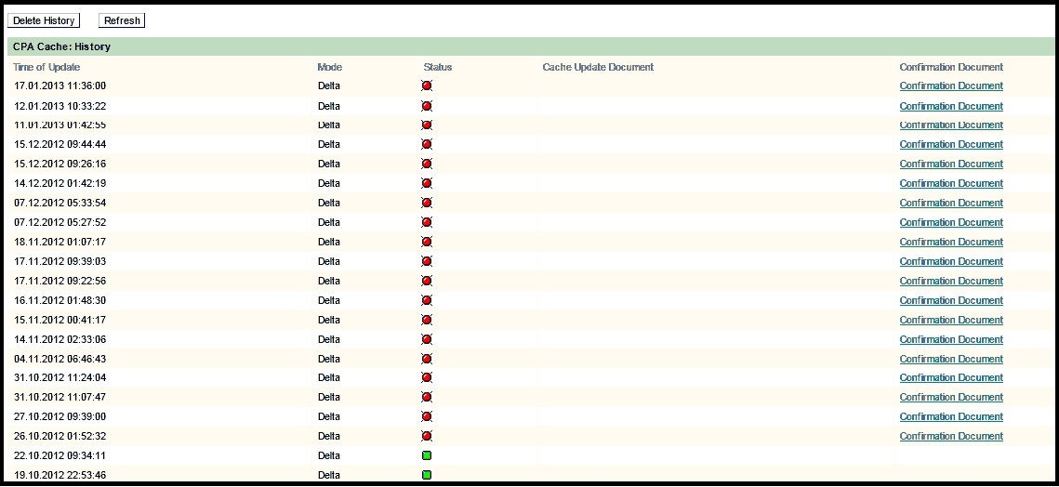
CPA Cache History
CPA Cache History could be accessed in one of the following ways:
Open a browser and go to http://<host>:<port>/pimon to access the Process Integration tools. Then choose Monitoring >> Adapter Engine >> Channel Independent Log
Click on the CPA cache history
Copyright © Capgemini 2016. All Rights Reserved
15

Slide 24
Channel Independent Log
Display processing steps of adapters that cannot be assigned to a particular communication channel. Select an adapter to display information about all entries for processing for this adapter.
Channel Independent Log could be accessed in one of the following ways:
Open a browser and go to http://<host>:<port>/pimon to access the Process Integration tools. Then choose Monitoring >> Adapter Engine >> Channel Independent Log
Click on the Channel Independent Log
Copyright © Capgemini 2016. All Rights Reserved
15

Slide 25
Component based alerts
Component-Based Message Alerting (CBMA) is the new way of sending alerts on SAP PI (either single or double stack) without the use of any additional components. CBMA is made of three components:
a) Central configuration for creating alerts - Alerts can be created in Integration Directory or in Netweaver Administrator
b) Alert Engine - which is supposed to evaluate rules and create alerts
c) Alert receivers (consumers) - components which can receive alerts from the Alert Engine
Copyright © Capgemini 2016. All Rights Reserved
15

Slide 26
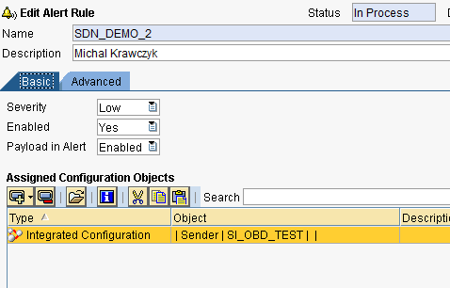
Component based alerts
Step 1 - Create alerts in Integration Directory
We need to specify a new alert rule and assign PI objects to that rule as shown in Figure below
Specify alert severity, if the alert rule is enabled (or disabled) and if the payload should be included in the alert message.
Copyright © Capgemini 2016. All Rights Reserved
15

Slide 27
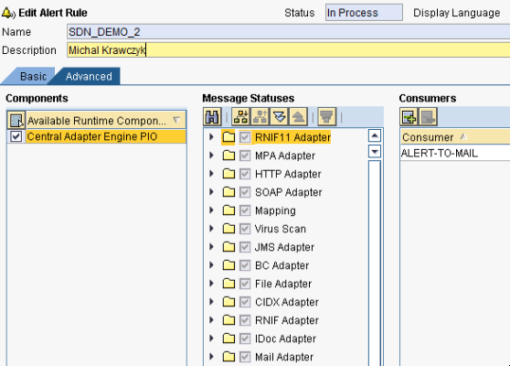
Component based alerts
Step 2 - Specify which types of alerts should be included in the alert rule like for example all alerts from a single adapter type (file or jdbc), etc. You also need to specify an alert receiver (consumer), which in this case will be an e-mail service.
Copyright © Capgemini 2016. All Rights Reserved
26

Slide 28
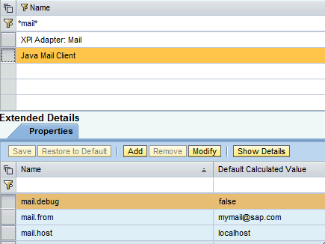
Component based alerts
Step 3 - Configure alert consumer for e-mail notifications. There is a new JavaMail Client Service which needs to be configured on the in order to be able to consume alert messages on the JAVA stack
Copyright © Capgemini 2016. All Rights Reserved
27

Slide 29
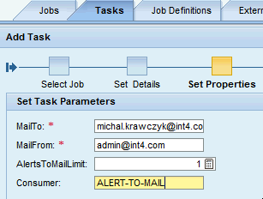
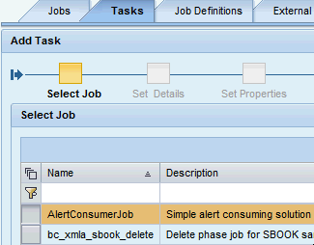


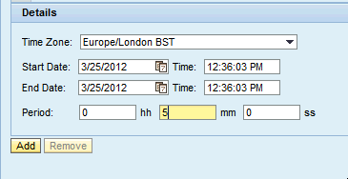
Component based alerts
Step 4 - The last thing we need to do is to schedule a job that will be running and creating alert notifications from the generated alerts.
Open SAP Netweaver admin: Operations -> Jobs -> Java Scheduler -> Job Definitions
Copyright © Capgemini 2016. All Rights Reserved
27

Slide 30
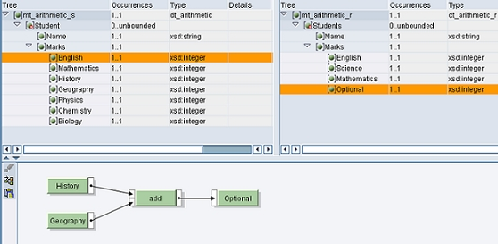
Types of Mapping in SAP PI
Graphical Mapping :
Graphical mapping is a common approach followed for generating desired target structure. It involves simple drag-n-drop to correlate respective nodes (fields) from source and target structure.
Copyright © Capgemini 2016. All Rights Reserved
3

Slide 31
Types of Mapping in SAP PI
Java Mapping :
Java Mapping is used when the graphical mapping will not fit for your requirement
JAVA mappings improves the performance and are preferred as they gets executed on J2EE engine directly.
In case of graphical mapping, XI/PI converts the mapping program into executable Java code internally based on graphical design and executes it on J2EE making it comparatively less efficiency.
Java mappings are more useful when performance of integration server is concerned during runtime.
Java mappings are parsing programs that can be developed in NWDS (NetWeaverDeveloperStudio), import as .jar files and can be used in the mapping part of Enterprise Service Repository.
Copyright © Capgemini 2016. All Rights Reserved
3

Slide 32
Types of Mapping in SAP PI
Graphical Mapping
Java Mapping
XSLT Mapping
ABAP Mapping
Copyright © Capgemini 2016. All Rights Reserved
3

Slide 33
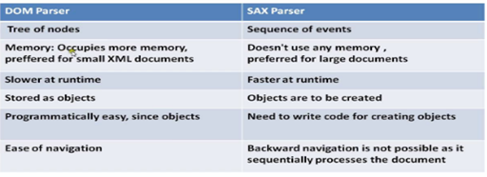
Types of Mapping in SAP PI
Java Mapping uses 2 types of parsers. i.e., DOM and SAX.
Help Link : https://blogs.sap.com/2015/09/18/develop-java-mapping-in-pi-74-java-only/
Copyright © Capgemini 2016. All Rights Reserved
3

Slide 34
Types of Mapping in SAP PI
XSLT Mapping :
XSLT Mappings are preferred to use when the graphical mappings cannot help in case of complex structures.
When the choice is between Java And XSLT, XSLT is simpler than java mapping and easier. But, it has its drawbacks. We cannot use Java APIs and Classes in it.
So, if you want to use some specific Java API's you will have to go for Java Mapping.
XSLT mapping is not suggestible for large source xml data
Help link for ABAP Mapping :
http://saptechnical.com/Tutorials/XI/ABAPMapping/page1.htm
Copyright © Capgemini 2016. All Rights Reserved
3

Slide 35
Node functions in SAP PI
Different types of mapping functions available :
Arithmetic
Boolean
Text
Functions
Date
Constants
Node Functions
Statistics
Copyright © Capgemini 2016. All Rights Reserved
3

Slide 36
User Defined Functions
User defined functions(UDFs) are used in graphical mapping to fulfill the requirement in a easy manner using a small piece of Java code.
UDF's are of two types:
a. Simple UDF , which takes in one input and gives out one output.
b. Advanced UDF, where in u can access more than one fields and the result is passed on to Result List.
UDFs will have two different execution types:
a. All values of a context
b. All values of a queue
Help link :
https://wiki.scn.sap.com/wiki/pages/viewpage.action?pageId=79954137
Copyright © Capgemini 2016. All Rights Reserved
3

Slide 37
DEMO
Copyright © Capgemini 2016. All Rights Reserved
3

